Slide 1
Computer Architecture Experiment
Topic 6. Dynamically Scheduled Pipelines using Scoreboarding
浙江大学计算机学院

Slide 2
Outline
Experiment Purpose
Experiment Task
Basic Principle
Operating Procedures
Checkpoints

Slide 3
Experiment Purpose
Understand the principle of pipelines that support multicycle operations.
Understand the principle of Dynamic Scheduling With a Scoreboard.
Master the design methods of pipelines that support multicycle operations.
Master the design methods of Dynamically Scheduled Pipelines using Scoreboarding.
Master verification methods of Dynamically Scheduled Pipelines using Scoreboarding.

Slide 4
Experiment Task
Redesign the pipelines with IF/IS/RO/FU/WB stages and supporting multicycle operations.
Design of a scoreboard and integrate it to CPU.
Verify the Pipelined CPU with program and observe the execution of program.

Slide 6
Status
Status | Wait until | Bookkeeping
Issue (Structural and WAW) | !busy[FU] && !result[RD] | busy[FU] = 1, op[FU] = OP, dst[FU] = RD, src1[FU] = RS1, src2[FU] = RS2, read1[FU] = result[RS1], read2[FU] = result[RS2], wait1[FU] = !read1[FU], wait2[FU] = !read2[FU], result[RD] = FU
Read operands (RAW) | wait1[FU] && wait2[FU] | wait1[FU] = 0, wait2[FU] = 0
Function unit | Function unit completes its work
Write back (WAR) | ∀f, !(src1[f] == dst[FU] && wait1[FU] || src2[f] == dst[FU] && wait2[FU]) or similarly ∀f, (src1[f] != dst[FU] || !wait1[FU]) && (src2[f] != dst[FU] || !wait2[FU]) | ∀f, if read1[f] == FU then wait1[f] = 1, if read2[f] == FU then wait2[f] = 1. result[ dst[FU] ] = 0, busy[FU] = 0

Slide 7
Instr. Mem.(1)
NO. | Instruction | Addr. | Label | ASM | Comment
0 | 00000013 | 0 | __start: | addi x0, x0, 0 | Str.(in 2nd round with 60
1 | 00402103 | 4 |  | lw x2, 4(x0)
2 | 00802203 | 8 |  | lw x4, 8(x0) | Structural Haz.(0x4)
3 | 004100b3 | C |  | add x1, x2, x4
4 | fff08093 | 10 |  | addi x1, x1, -1 | Struct.,WAW(with 0xC)
5 | 00c02283 | 14 |  | lw x5, 12(x0)
6 | 01002303 | 18 |  | lw x6, 16(x0)
7 | 01402383 | 1C |  | lw x7, 20(x0) | Done at the same time Write respectively
8 | 402200b3 | 20 |  | sub x1, x4, x2 | done at the same time
9 | ffd50093 | 24 |  | addi x1, x10,-3
10 | 00520c63 | 28 |  | beq x4,x5,label0
11 | 00420a63 | 2C |  | beq x4,x4,label0
12 | 00000013 | 30 |  | addi x0, x0, 0 | not executed
13 | 00000013 | 34 |  | addi x0, x0, 0 | not executed
14 | 00000013 | 38 |  | addi x0, x0, 0 | not executed

Slide 8
Instr. Mem.(1)
NO. | Instruction | Addr. | Label | ASM | Comment
15 | 00000013 | 3C |  | addi x0, x0, 0 | not executed
16 | 000040b7 | 40 | label0: | lui x1, 4
17 | 00c000ef | 44 |  | jal x1, 12 | WAW(with 0x40)
18 | 00000013 | 48 |  | addi x0, x0, 0 | not executed
19 | 00000013 | 4C |  | addi x0, x0, 0 | not executed
20 | ffff0097 | 50 |  | auipc x1, 0xffff0
21 | 0223c433 | 54 |  | div x8, x7, x2
22 | 025204b3 | 58 |  | mul x9, x4, x5
23 | 022404b3 | 5C |  | mul x9, x8, x2 | Struct.,WAW(58);RAW(54)
24 | 00400113 | 60 |  | addi x2, x0, 4 | WAR(with 0x5C)
25 | 000000e7 | 64 |  | jalr x1, 0(x0)
26 | 00000013 | 68 |  | addi x0, x0, 0 | not executed
27 | 00000013 | 6C |  | addi x0, x0, 0 | not executed

Slide 9
Actual Completion Sequence
NO. | Addr | ASM | Comment
0 | 0 | addi x0, x0, 0
1 | 4 | lw x2, 4(x0) | x2=0x8
2 | 8 | lw x4, 8(x0) | x4=0x10
3 | C | add x1, x2, x4 | x1=0x18
4 | 10 | addi x1, x1, -1 | x1=0x17
5 | 14 | lw x5, 12(x0) | x5=0x14
6 | 18 | lw x6, 16(x0) | x6=0xFFFF0000
7 | 20 | sub x1, x4, x2 | x1=0x8
8 | 1C | lw x7, 20(x0) | x7=0x0FFF0000
9 | 24 | addi x1, x10,-3 | x1=0xFFFFFFFD
10 | 28 | beq x4,x5,label0 | no jump
11 | 2C | beq x4,x4,label0 | jump to 0x40
12 | 40 | lui x1, 4 | x1=0x4000
13 | 44 | jal x1, 12 | x1=0x48
14 | 50 | auipc x1, 0xffff0 | x1=FFFF0050

Slide 10
Actual Completion Sequence
NO. | Addr | ASM | Comment
15 | 58 | mul x9, x4, x5 | x9=0x140
16 | 64 | jalr x1, 0(x0) | x1=0x68
17 | 54 | div x8, x7, x2 | x8=0x01FFE000
18 | 60 | addi x2, x0, 4 | x2=0x4
19 | 5C | mul x9, x8, x2 | x9=0x0FFF0000
15：54的除法需要计算36周期，时间较久，进入EX阶段之后不会马上结束。58的乘法issue后，5C的乘法由于结构竞争无法issue，直到58执行结束。因此第一条执行结束写回结果的是58。
16：58执行结束后，5C、60依次issue，但5C需要等待54的结果x8，暂时无法执行。60与5C在x2上存在WAR，因此在5C读取x2进入EX阶段之前也不能写结果。所以，目前存在“60写x2→5C读x2、x8→54写x8”的等待关系，在54结束之前5C、60都无法完成。64没有上述问题，因此正常issue后第二个完成。
17：64使得控制流跳转，从代码开头开始执行，但其第一条指令就是需要用到ALU的，因此与60产生结构竞争，无法issue。由于指令只能依次issue，执行就卡在这里，直到54执行完成。
18：54执行完成之后，5C读x2、x8进入EX阶段，此时60就可以写回x2了。
19：最后经过几个周期的计算，5C也写回其计算结果。

Slide 11
Data Mem.
NO. | Data | Addr. | Comment
0 | 000080BF | 0
1 | 00000008 | 4
2 | 00000010 | 8
3 | 00000014 | C
4 | FFFF0000 | 10
5 | 0FFF0000 | 14
6 | FF000F0F | 18
7 | F0F0F0F0 | 1C
8 | 00000000 | 20
9 | 00000000 | 24
10 | 00000000 | 28
11 | 00000000 | 2C
12 | 00000000 | 30
13 | 00000000 | 34
14 | 00000000 | 38
15 | 00000000 | 3C
NO. | Instruction | Addr. | Comment
16 | 00000000 | 40
17 | 00000000 | 44
18 | 00000000 | 48
19 | 00000000 | 4C
20 | A3000000 | 50
21 | 27000000 | 54
22 | 79000000 | 58
23 | 15100000 | 5C
24 | 00000000 | 60
25 | 00000000 | 64
26 | 00000000 | 68
27 | 00000000 | 6C
28 | 00000000 | 70
29 | 00000000 | 74
30 | 00000000 | 78
31 | 00000000 | 7C

Slide 12
Test Bench
RV32core core(
.debug_en(1'b0),
.debug_step(1'b0),
.debug_addr(7'b0),
.debug_data(),
.clk(clk),
.rst(rst),
.interrupter(1'b0)
);
initial begin
clk = 0;
rst = 1;
#2 rst = 0;
end
always #1 clk = ~clk;

Slide 13
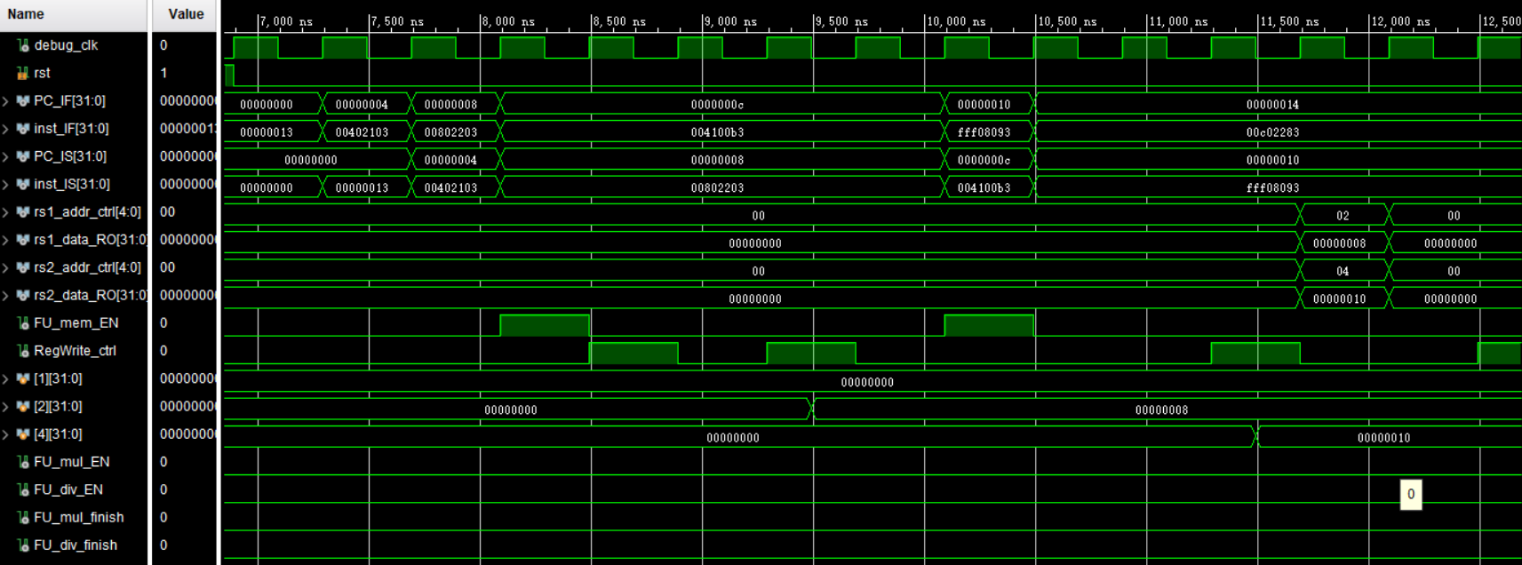
Simulation (1)

Slide 14
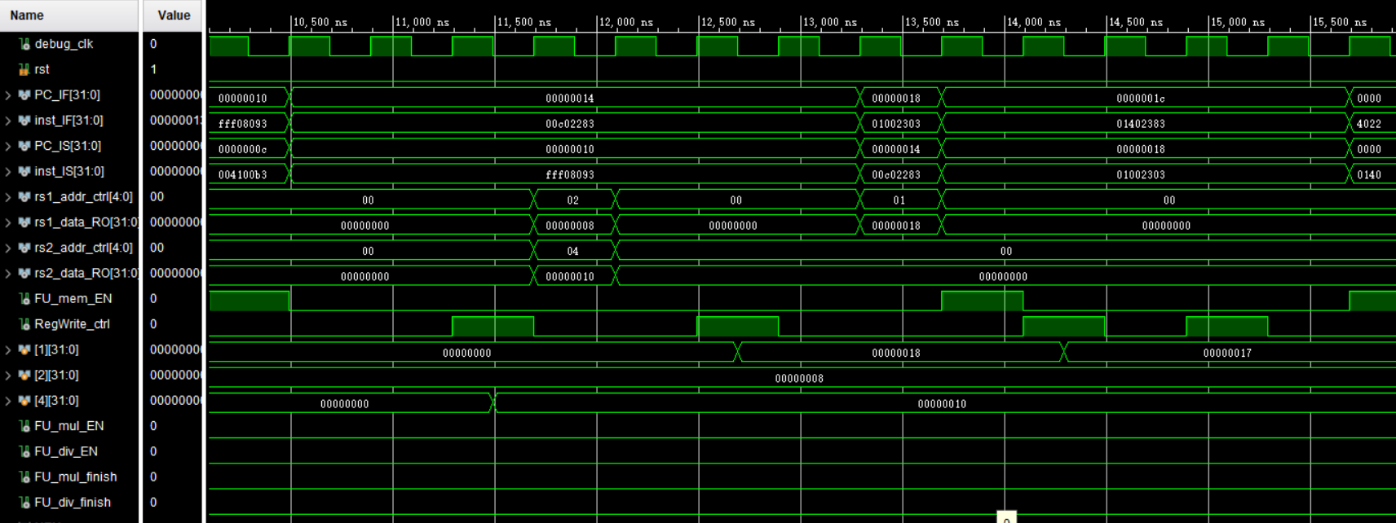
Simulation (2)

Slide 15
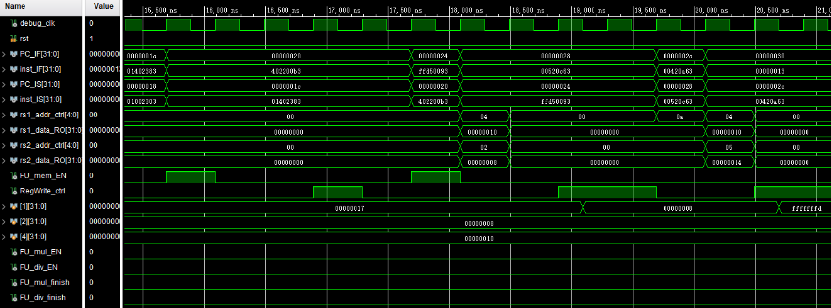
Simulation (3)

Slide 16
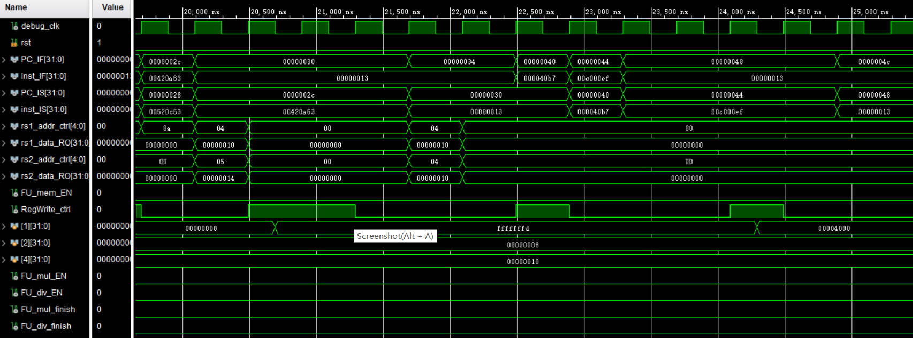
Simulation (4)

Slide 17
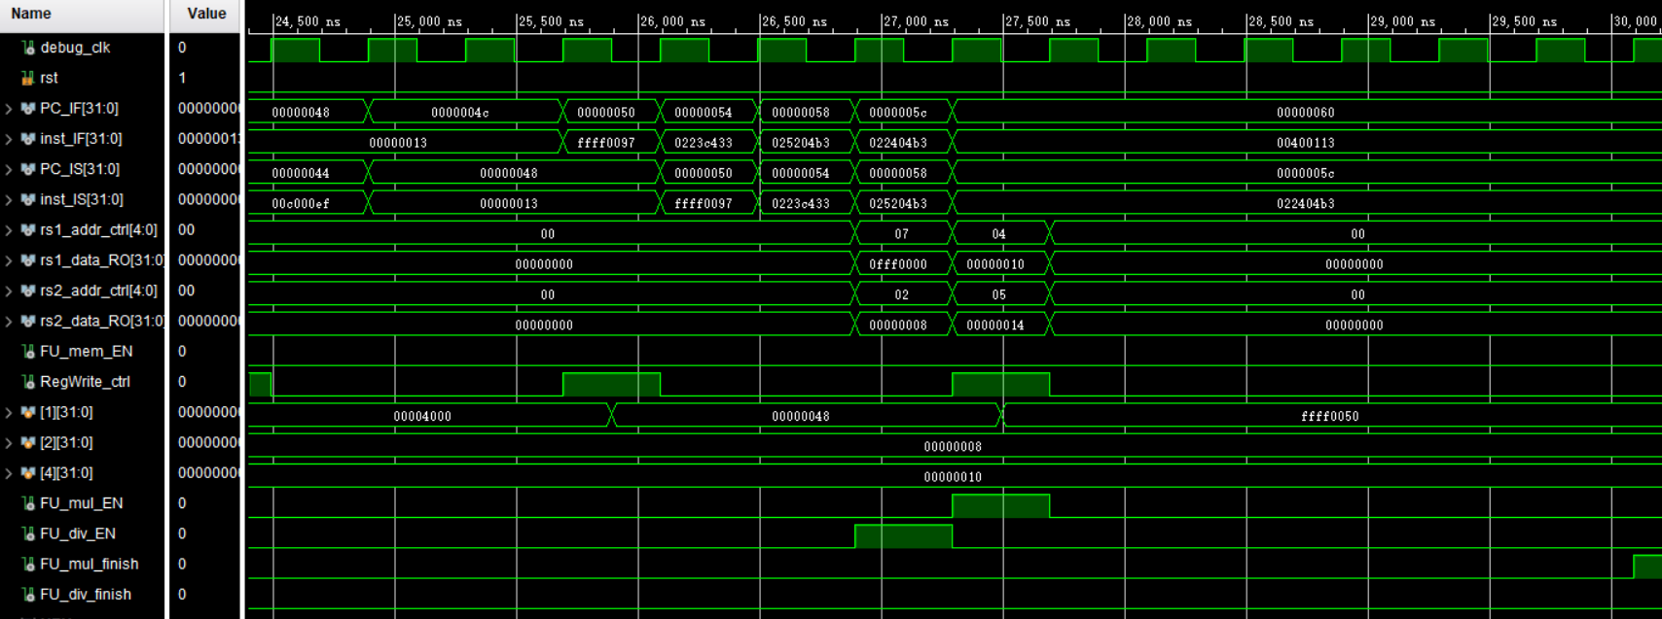
Simulation (5)

Slide 18
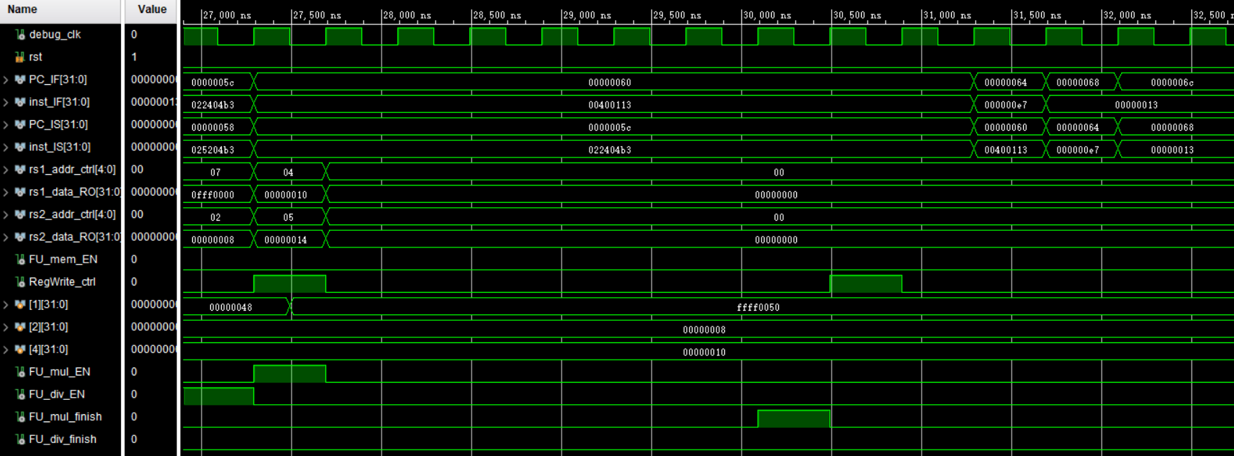
Simulation (6)

Slide 19
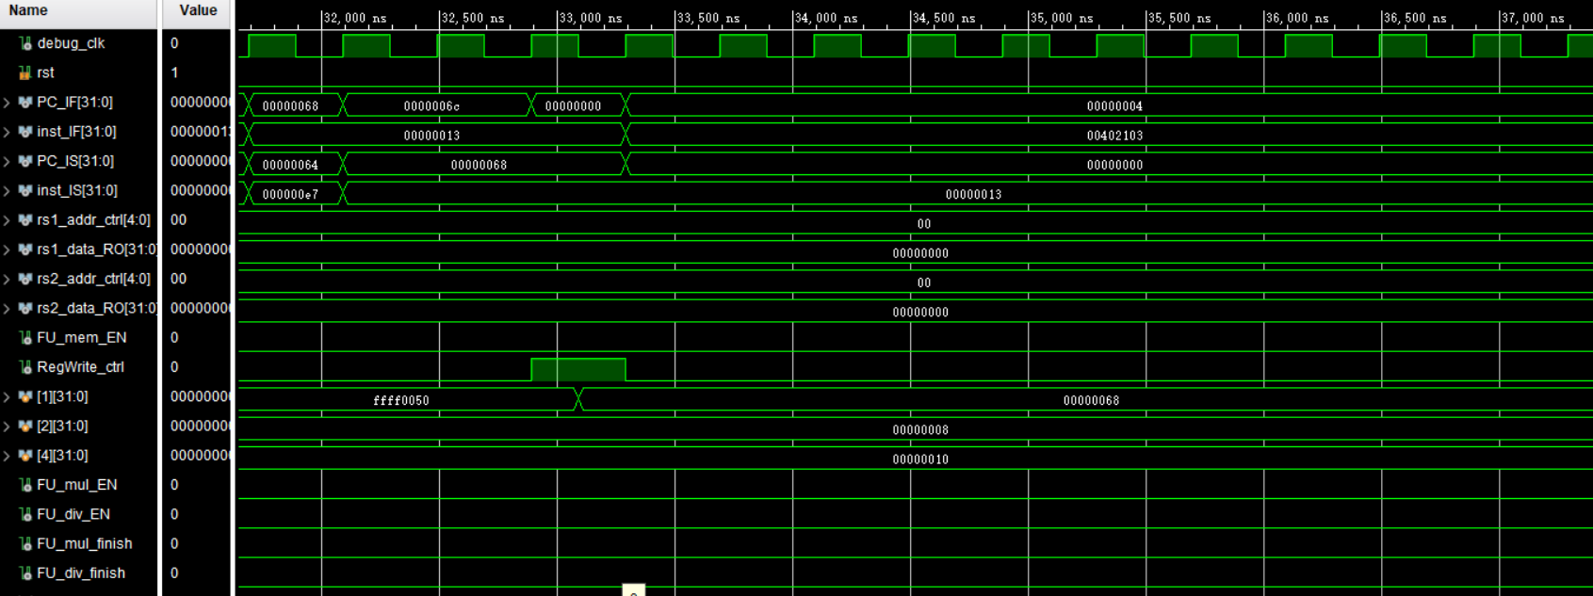
Simulation (7)

Slide 20
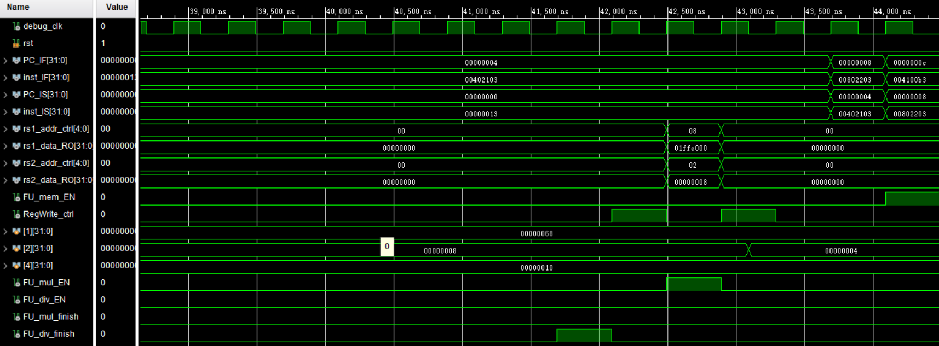
Simulation (8)

Slide 21
Checkpoints
CP 1:
Waveform Simulation of the Pipelined CPU with the verification program
CP 2:
FPGA Implementation of the Pipelined CPU with the verification program

Slide 22
Thanks!

